Slide 1
Note for presenters:
This presentation is designed as an aid to help you share your career journey with students.
Please remember to keep the presentation conversational and get to know your audience!
Personalize your presentation by:
Updating slides 9-11 with your personal information and fun pictures prior to the presentation.
Making your time with the students fun by sharing your journey in a way they can understand. Remember these students have little to no experience in accounting.
Reviewing the Notes section of the slides for presenter tips and opportunities to engage the students.

Slide 2







discover your future
Discover a Career with Endless Possibilities

Slide 3



Career Aspirations
Dream roles in dream companies
What is your dream job?
Company name:
Job title:
Responsibilities:
Why this is my dream job:
Notes:
Have students think about their dream job: company name, job title, responsibilities, etc. Call on a few to share with the class.

Slide 4



What do these careers have in common?
Notes:
What if I told you that what I do allows me to work with any of those jobs you just mentioned? Can you think of something that all these things have in common?

Slide 5
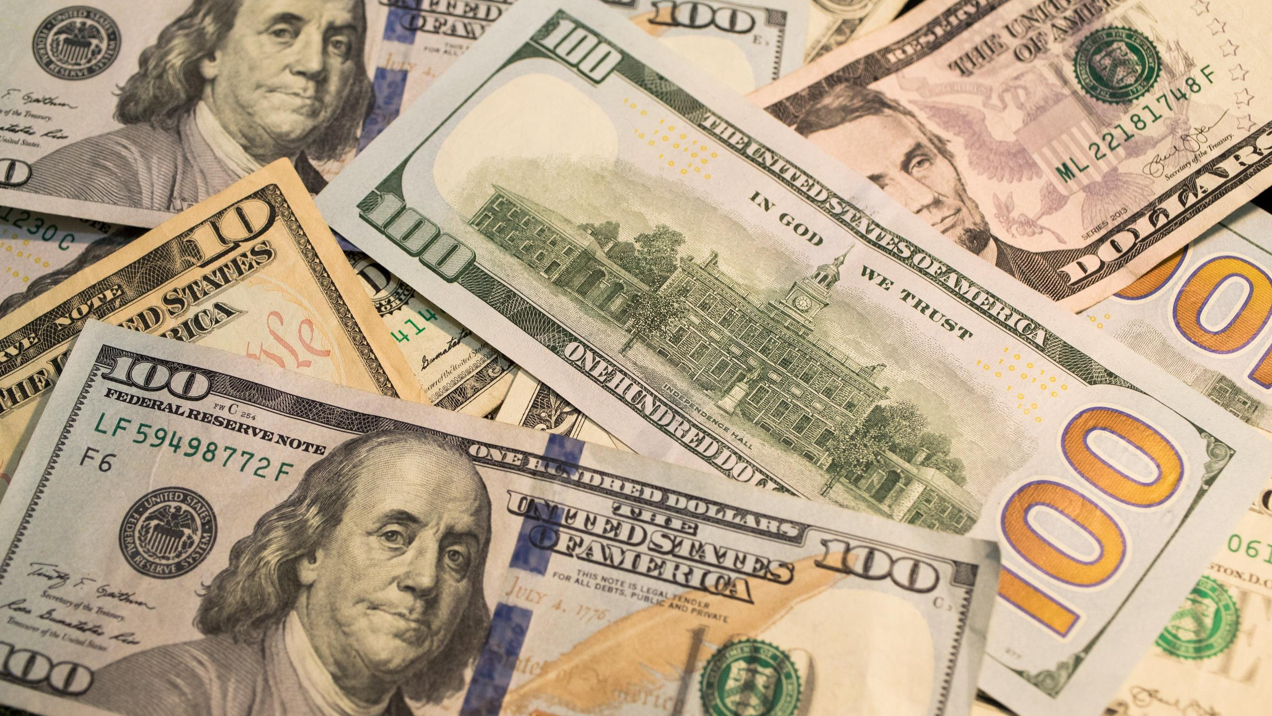

money
+
accountants
Notes:
Money is what all of these have in common, right? And who manages the money? People called Accountants.

Slide 6



What do you do with money?
  Save
  Invest
  Donate
  Spend
Notes:
What do you do when you get money - either from a job, an allowance, or as a gift?
Call on people.
Some of you might save your money, some might want to buy something new. Everyone uses money differently. Many adults and businesses also need help with money. Accountants help manage their money and make sure their business can be successful.

Slide 7

ac count ant
noun
a person whose job is to keep, inspect, and analyze financial accounts
“accountants are responsible for their client’s personal and professional information”
Oxford Dictionary Definition
Notes:
The Oxford Dictionary defines an accountant as: a person whose job is to keep, inspect, and analyze financial accounts.

Slide 8

what do accountants do?
Work in any industry
Own your own business
Money Organizers | Problem Solvers
Know how much money a person or business makes or spends on supplies Keep organized records of money spent and earned Ensure records are accurate and easy to understand Determine whether a business is making or losing money | Find and solve money problems Analyze where money is going and identify opportunities for better processes Detect suspicious transactions if money is missing Help individuals and businesses make big financial decisions (like saving for college or buying a new store)
Notes:
Now that we know what an accountant is… what do accountants do?
Accountants are Money Organizers. Just like you might use a calendar to keep track of homework, or a locker to organize your stuff, accountants organize financial information. They know how much money a person or business makes and spends to ultimately determine whether a business is making or losing money.
Accountants are Problem Solvers. They are like detectives who use numbers to find and fix money-related issues! Like in the event money is missing, they can detect suspicious transactions and look for irregularities. And they help individuals and businesses make big financial decisions, like saving for college or buying a new store.

Slide 9



What I do...
Company name:
Job title:
Responsibilities:
Why this is my dream job:
Notes:
Personalize this slide with information about your current job and replace the person icon with a fun picture of yourself.

Slide 10



This has allowed me to...
  Share something you’re involved in that you’re passionate about
  Share things that being a CPA has afforded you the ability to do
Notes:
Personalize this slide with things you are passionate about, or things that being a CPA has afforded you the lifestyle to be able to do. Replace the person icon with a fun picture of yourself!

Slide 11


But before this I was in your shoes.
Want to know what I did?
  Share classes you took
  Organizations you were a part of
  Jobs you had before graduation
  Volunteering opportunities
Notes:
Before I got to where I am today, I was in your shoes. Want to know what I did? Talk about classes you took in high school, organizations you were a part of, jobs you had, volunteering you did, etc.

Slide 12
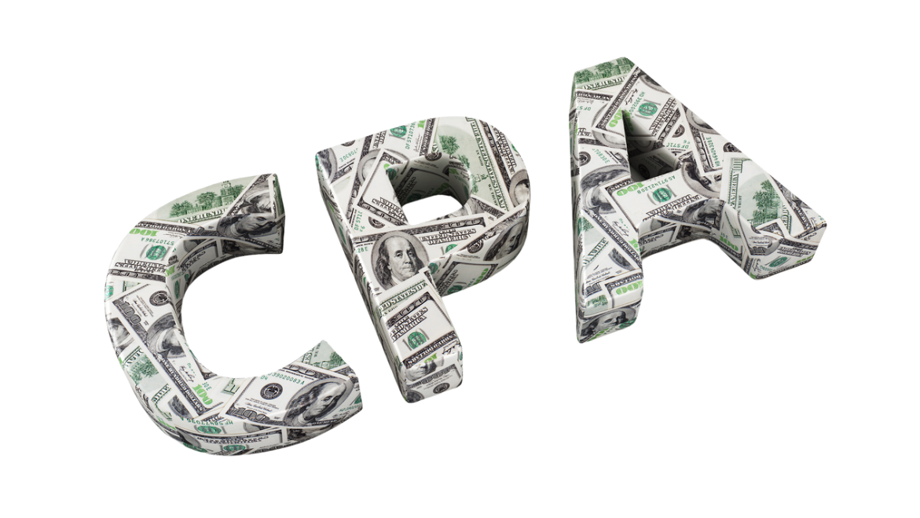





becoming a
certified public accountant
+
+
+
Education
Experience
Ethics*
Exam
=
CPA
*Certain states require a separate ethics assessment in addition to what is tested on the CPA Exam.
Notes:
And along the way (share your specific story here), I decided I wanted, not to just be an Accountant, but I wanted to be a licensed professional. To show I'm among the top in my field. So I became a Certified Public Accountant. This means I took some extra hours of school, passed a 4-part exam and met the licensure requirements in my state to become a CPA. Just like Doctors and Lawyers have to work a little extra hard, so do CPAs. And just like for Doctors and Lawyers, becoming a CPA means more money too.

Slide 13

do you have what it takes to become a cpa?
Do you like puzzles?
Do you like working in teams?
Do you like technology?
Do you like helping people?
Notes:
So, could accounting be right for you? Do you have what it takes to become a CPA?
Make this part interactive and ask the students to raise their hand for each question they relate to. If this sounds like you, explore accounting!

Slide 14


Action Steps to start today
High School
College
Status | Task
 | Take an accounting class if your school offers one
 | Join a business club or organization (i.e., DECA, BPA, FBLA)
 | Discuss accounting with a career counselor
 | Ask the adults in your life if they know an accountant you can shadow for a day
Status | Task
 | Take an accounting class
 | Join an accounting club like Beta Alpha Psi
 | Discuss accounting with a career counselor or academic advisor
 | Find an accounting internship or a CPA you can shadow for a day
 | Get involved with your local state CPA society
Notes:
I mentioned some things I did when I was in your shoes. Here's a checklist of some things you can do to start exploring accounting: take an accounting class if available, join a business club or organization, discuss accounting with a career counselor and ask the adults in your life if they know an accountant you can shadow for a day.
When you get to College, continue those accounting classes, join an accounting specific club, and eventually start looking for accounting internships. You can even get involved with your local state CPA society <promote your local state CPA society here>. When I went to college, I… (talk about organizations you were a part of, internships you had, etc.).

Slide 15

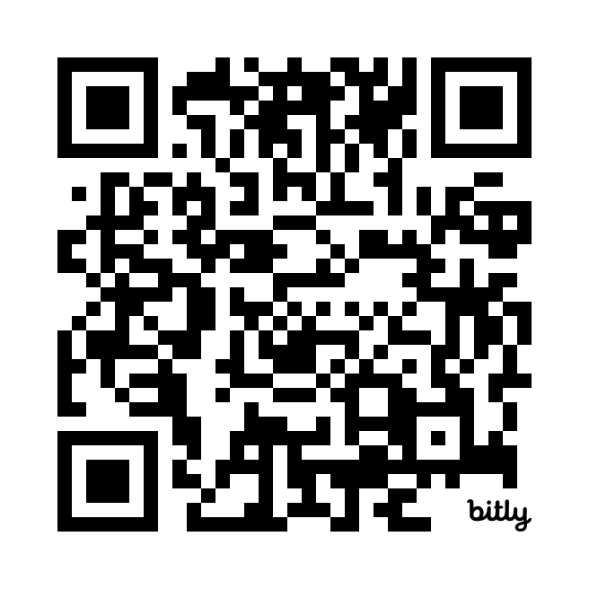

Want to learn more?
Learn about becoming a CPA in Texas!
futuretx.cpa
thiswaytocpa.com
Notes:
Personalize this page with information about your state CPA society. Include the logo, website and QR codes and information about high school specific programs and resources.

Slide 16


Join the AICPA as a free
Student Member
Hear more about different careers
you can have as a CPA.
Apply for scholarships to help
pay for college.
Build your LinkedIn profile with templates and professional advice.
Receive guidance and tips for landing
your first job.
Notes:
A great way to get started is to join the AICPA as a free student member. The AICPA & CIMA is the most influential global network of management and public accountants, with nearly 600,000 members worldwide. As a member association, they are here to support you throughout your entire journey, providing membership for high school students, college students, CPA exam candidates and licensed CPAs.
As a student member, you receive access to monthly webinars where you can hear from CPAs in other industries; you can apply for scholarships to help you pay for college - the AICPA Foundation awards over $1M in scholarship funds each year to accounting majors; you receive templates and professional advice to build a LinkedIn profile that will have you standing out; and get help landing your first job with guidance and tips from professionals.

Slide 17






Follow us:
@TXCPA
Contact Us:
cpapipeline@tx.cpa
Notes:
Be sure to follow @txcpa on social media and reach out to this email address with any questions or if we can help you as you choose your future courses and career.

Slide 18
would you rather...
Optional End of Presentation Activity
Notes:
If time permits, have some fun with a quick “Would You Rather” game. Have students shout out their answers.

Slide 19
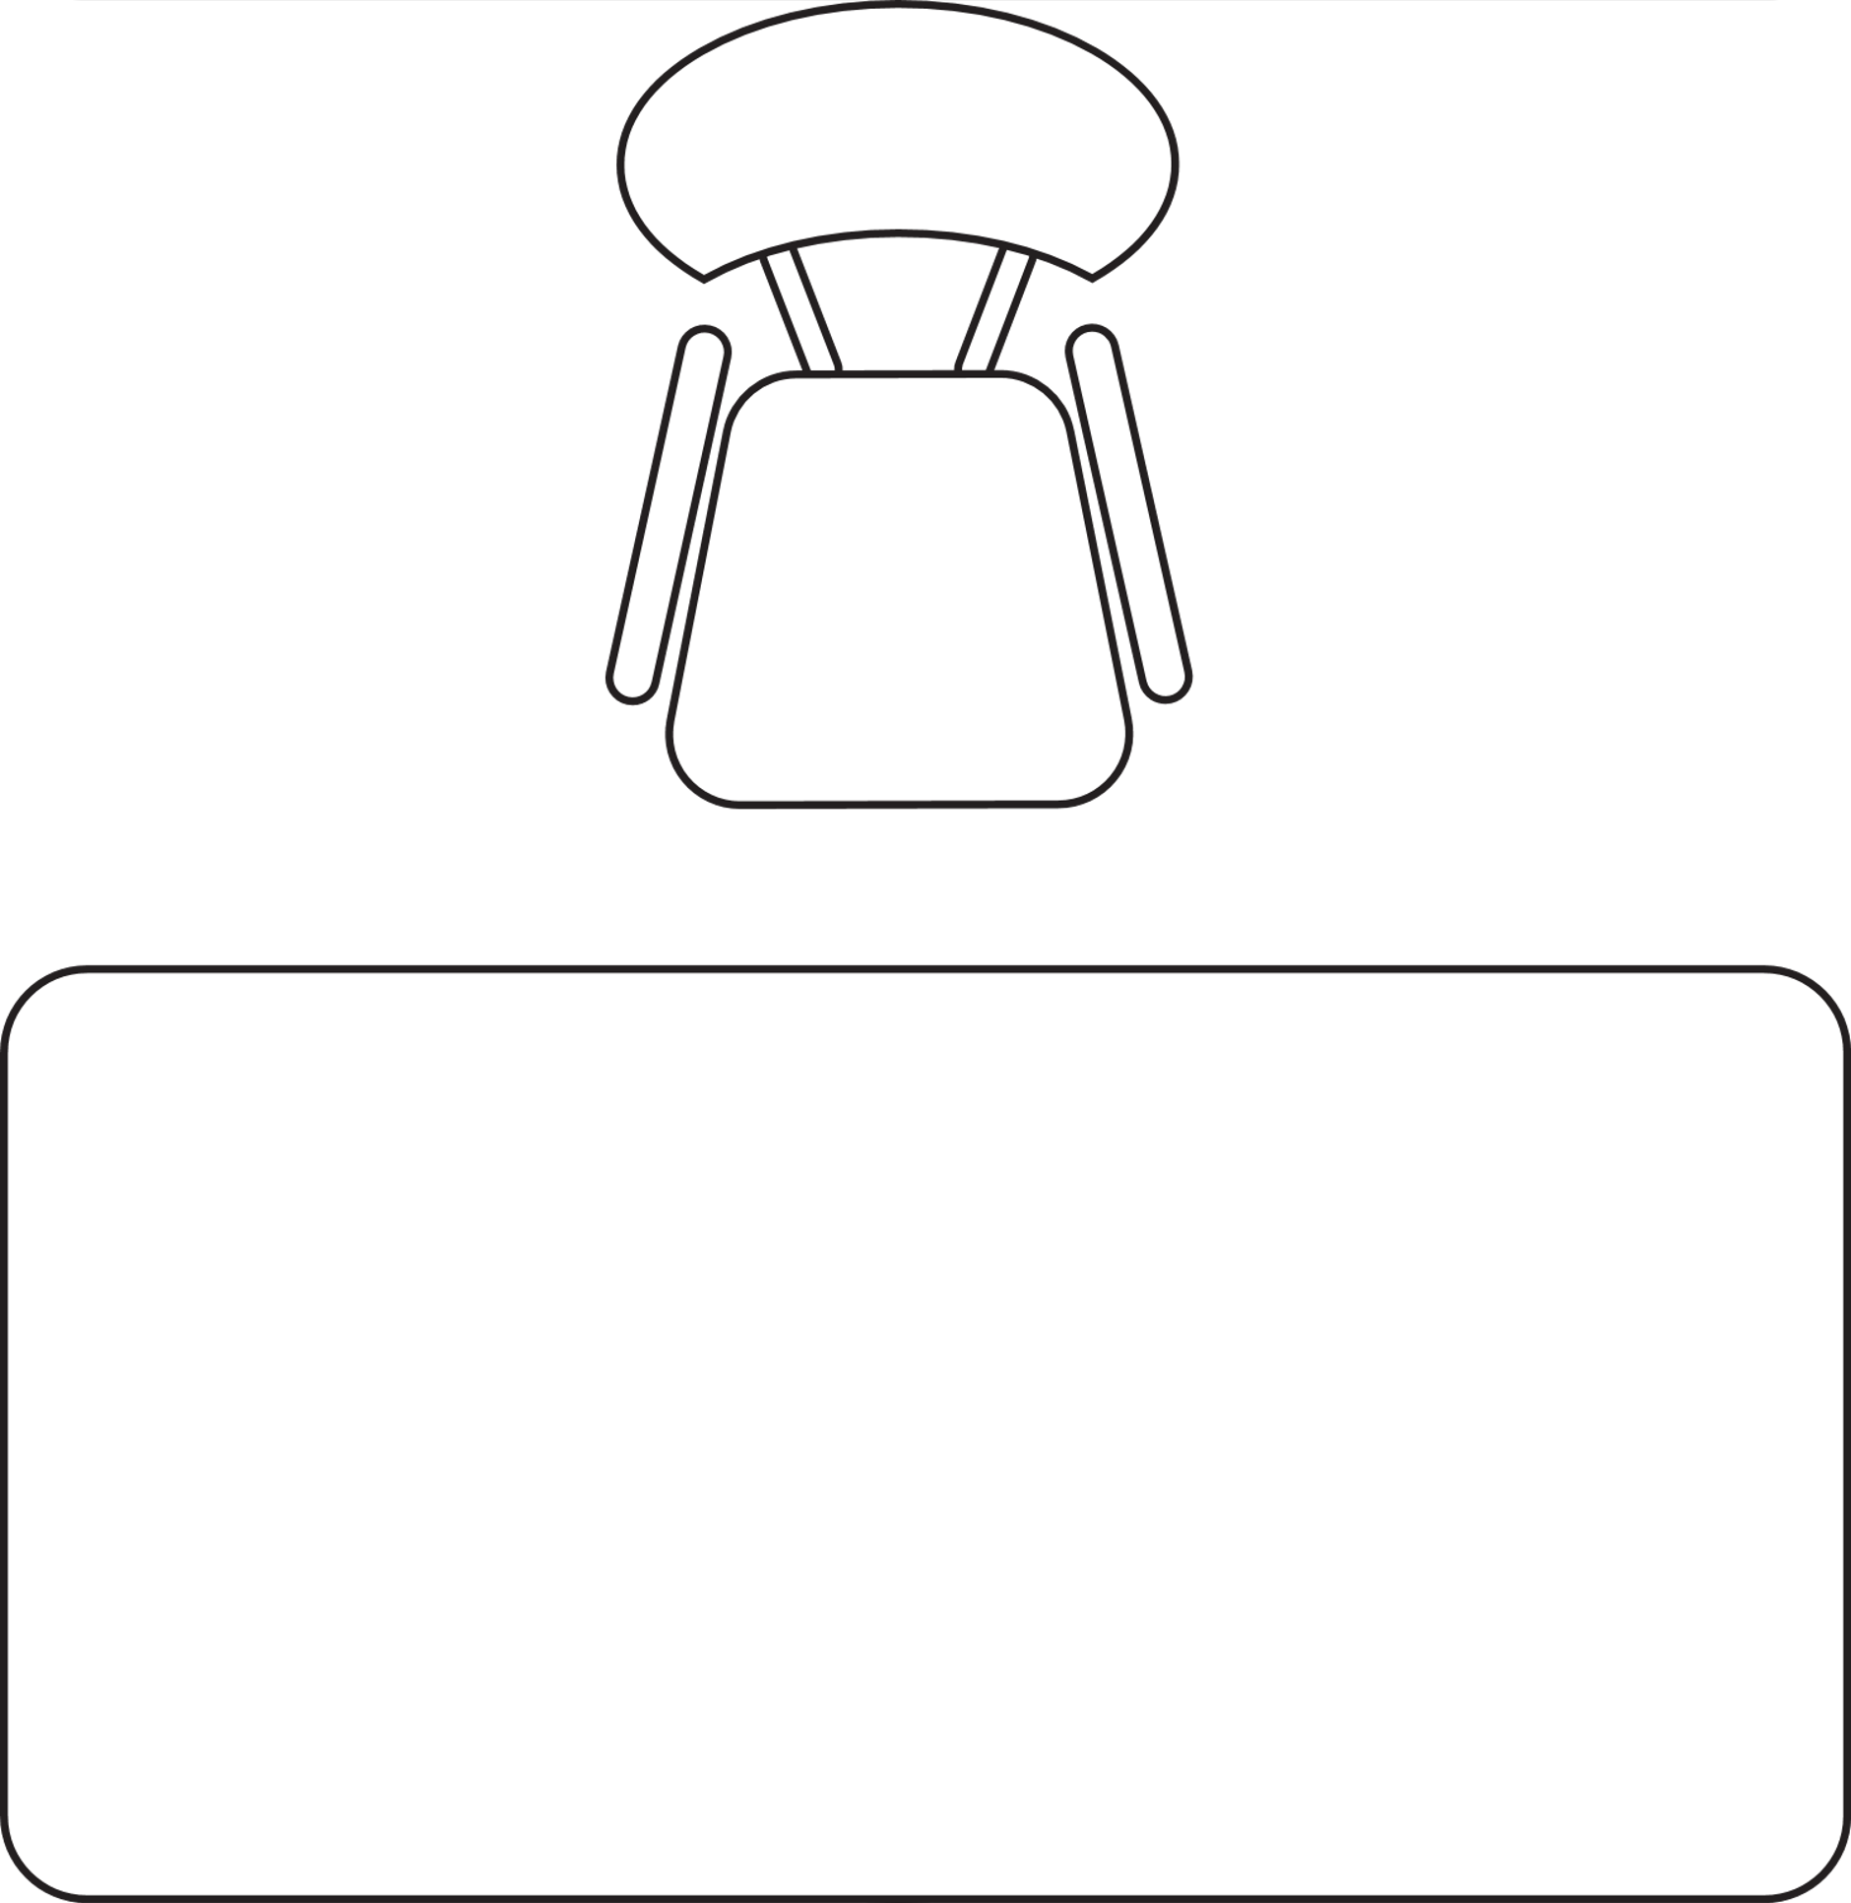


Work in a cube or travel for your job?

Slide 20


Work by yourself or work in a team?

Slide 21


investigate fraud or help save our planet?

Slide 22


track the money or tell a story?

Slide 23


work for a company or own your own business?

Slide 24
in accounting, there’s something for everyone!
Travel for your job
Work at a desk
Work in a team
Work by yourself
Investigate fraud
Protect the environment
Keep track of the money
Use finances to tell a story
Work for a company
Be your own boss
Notes:
No matter your preference, in accounting there is something for everyone!

Slide 25




questions?

